Slide 1
Credit Card Fraud Detection Using Neural Network Auto Encoders
Raparla Sravani
016656601
San Jose State University

Slide 2
How Credit Cards Is Frauded?
Types Of Fraud Detections:
Credit card frauds are usually carried out with the intent to make quick financial gains off the hard earned money of unaware and otherwise technologically inept victims.
The major reasons for credit card fraud include: Lack of adequate security protocols, use of stolen credit cards,posing as the legitimate account holder, phishing sites posing as genuine transaction portals, etc.
Types Of Credit Card Fraud:
1. Card Related Frauds
2.Merchant Related Frauds
3.Internet Frauds

Slide 3
a. Card Related Frauds
Application Fraud happens when frauder replaces the Actual one’s Application by detecting their personal details.
When Customer lost their Debit Or Credit Card ,The customer feels that his card was simply lost while the fraudster siphons money off the victim‘s account.
(Card Not Present): It is possible to transact without the actual physical possession of the card. Fraudsters knowing the card details such as card number and expiry date can still manage to commit frauds.

Slide 4
B. Merchant Related Frauds C. Internet Frauds
Happens when vendors pass on customer‘s otherwise confidential data to fraudsters for monetary gains.
They have massive plans like attract customers for some products like shopping carts and allow them to enter their Personal Details,Through that they have plans to make their fraudulent transactions.
Somehow, like same as Merchant Related Frauds.
This spyware tracks every keystroke made by the user and is later transmitted to a fraudster who then uses these personal details for committing transaction related frauds.
Cell Phone Camera Scam

Slide 5
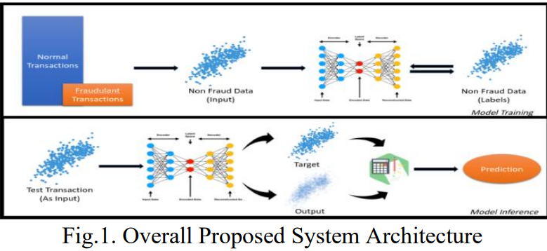
Fig.1. Overall Proposed System Architecture

Slide 6


The model comprises two parts: Encoder and Decoder.
The motive is to reconstruct the inputs back as target values instead of predicting new target values.
In an autoencoder network, there are connections between the layers but no connections exist inside the layer itself.
The cost function defined and used for the model is a simple mean squared error loss that can be represented as follows:
1/𝑛 S (𝑖 = 1) (𝑦𝑖 − 𝑦 𝑖) 2
This setup ensures that our model evaluation would be much more strict and less prone to random errors.

Slide 7
V. EXPERIMENTAL SETUP
Data Collection
Dataset Wrangling
Data Visualization & Analysis
Data Preprocessing
One hot encoding
Z Score Normalization
Data Clipping
Data Modelling

Slide 8
Data Collection:
We obtain a simulated credit card fraud detection dataset kaggle.
The dataset contains roughly 6 Million financial transactions divided into five categories: CASH IN, CASH OUT, DEBIT, PAYMENT and TRANSFER.
It runs slow when importing pandas.So,we have an alternative framework handlish “DASK”.
The dataset contains 8213 fraudulent transactions out of 6362620 transactions, which is approximately 0.12%.

Slide 9
Dataset Wrangling:
Inorder to train a powerful model, we need to ensure that the dataset is clean and suitable for training
We achieve that first by understanding the dataset by means of visualizations & analysis.
And,then later on by building upon this knowledge, cleaning and preprocessing the dataset as required.

Slide 10
Data Visualization & Analysis:
We have a total of 10 Columns in our transaction dataset. The data columns are a mixture of String, Numeric & boolean values. The column name, data type and the description of each column is denoted in the Table.1.
the dataset is highly imbalanced: 8213 fraudulent transactions out of 6362620 transactions. This huge class imbalance would need to be addressed before any model can be trained

Slide 11
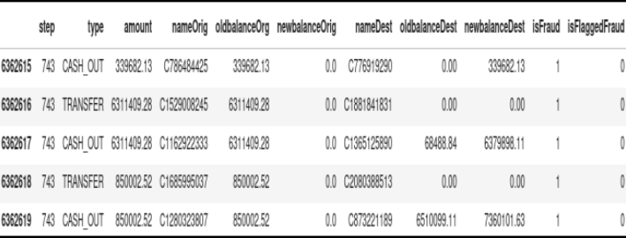
Fig.2. Snapshot of the Actual Dataset

Slide 12
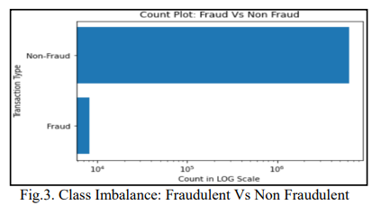
Fig.3. Class Imbalance: Fraudulent Vs Non Fraudulent

Slide 13
Data Preprocessing:
Data preprocessing is where we normalize and take other actions based on the analysis we did in the previous step. In this stage, we apply preprocessing steps such as Z Score normalization, One Hot encoding etc.
One hot encoding is the most widespread approach to dealing with categorical data when the number of categories is especially small in number.
Z Score Normalization in particular helps to avoid outlier issues that are present in case of Min-Max Normalization.
Data Clipping: This technique is employed when there is a defined range between which the non-outlier values must lie.

Slide 14
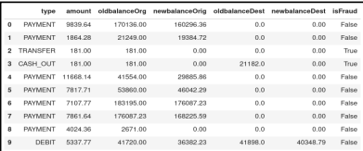
Raw dataset to Processed dataset looks as shown in Fig.4 and Fig.5 respectively:

Slide 15
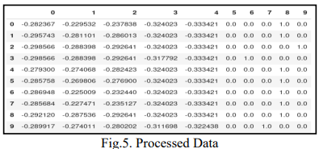

Slide 16
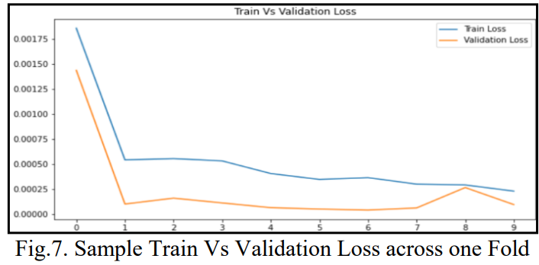
Data Modelling:
Based on how the training proceeds we can suitably alter the training to help the model learn better

Slide 17
CONCLUSION & FUTURE WORK:
Credit Card Fraud detection is a very serious problem.
We proposed an autoencoder model architecture for the problem of credit card fraud.
In the future, we will try to train and evaluate our model on a larger dataset and improve the computational efficiency of our model.
We will also try to incorporate more interesting features such as geographic location of transaction, frequency of transactions, etc.

Slide 18
REFERENCES:
Philip ,Chan & Fan, Wei & Prodromidis, Andreas & Stolfo, Salvatore. (2019). Credit Card Fraud Detection Distributed Data Mining. IEEE Intelligent Systems. 14. 10.1109/5254.87786570
Sam Maes, et al., ―Using bayesian and neural networks credit cards fraud detection,‖ p. 4, August 2002.
https://medium.com/@sravani.raparla/credit-card-fraud-detection-using-neural-network-auto-encoders-9adbed0bf29f

Slide 19


